Slide 1
WanderSphere AI Tour Geoguide: A Real-Time Sentiment-Driven Travel Recommendation System
AAI 551 Engineering Programming: Python!
Project Report
Instructor: Joseph Helsing
Team Members: Group 5
Komal Wavhal
Hemanth Bathini
Qijun JiangQijun Jiang

Slide 2
Agenda
 |  | 1. | Project Idea and Goal
 |  | 2. | Project Work
 |  | 3. | Web Scrapping
 |  | 4. | Data Analysis and Data Processing
 |  | 5. | Project Result Analysis
 |  | 6. | Future Work
 |  | 7. | Limitation
 |  | 8. | References

Slide 3

Team Members
Komal Wavhal
20034443
Qijun JiangQijun Jiang
CWID
Hemanth Bathini
CWID

Slide 4

WanderSphere AI Tour Geoguide: A Real-Time Sentiment-Driven Travel Recommendation System
Project Idea and Goal
WanderSphere is an innovative AI-powered tour guide designed to recommend personalized travel destinations and experiences in real-time based on the sentiment analysis of user feedback, reviews, and social media data.
The main goal of this project is to create a recommendation system that adapts to user preferences, mood, and sentiment, offering travel suggestions that align with individual tastes and real-time emotions.

Slide 5
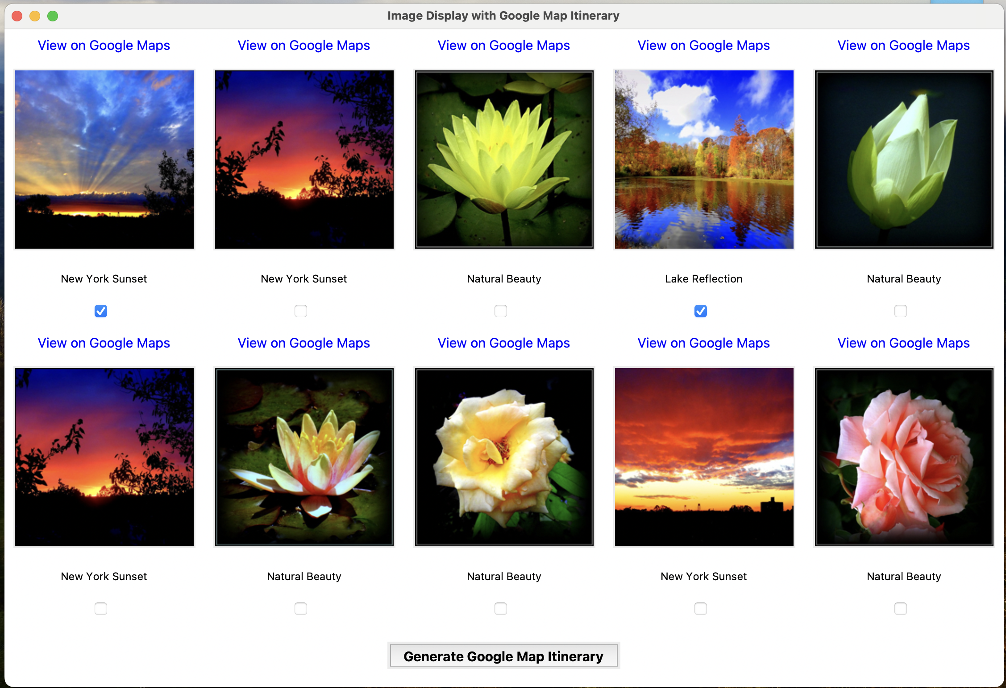
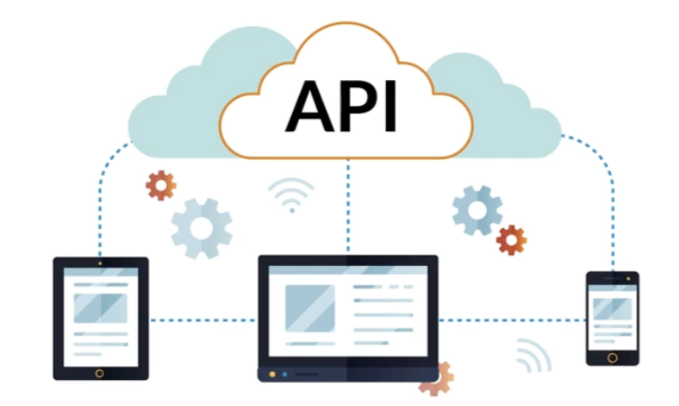


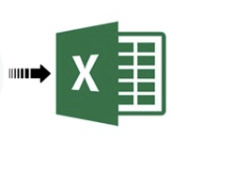



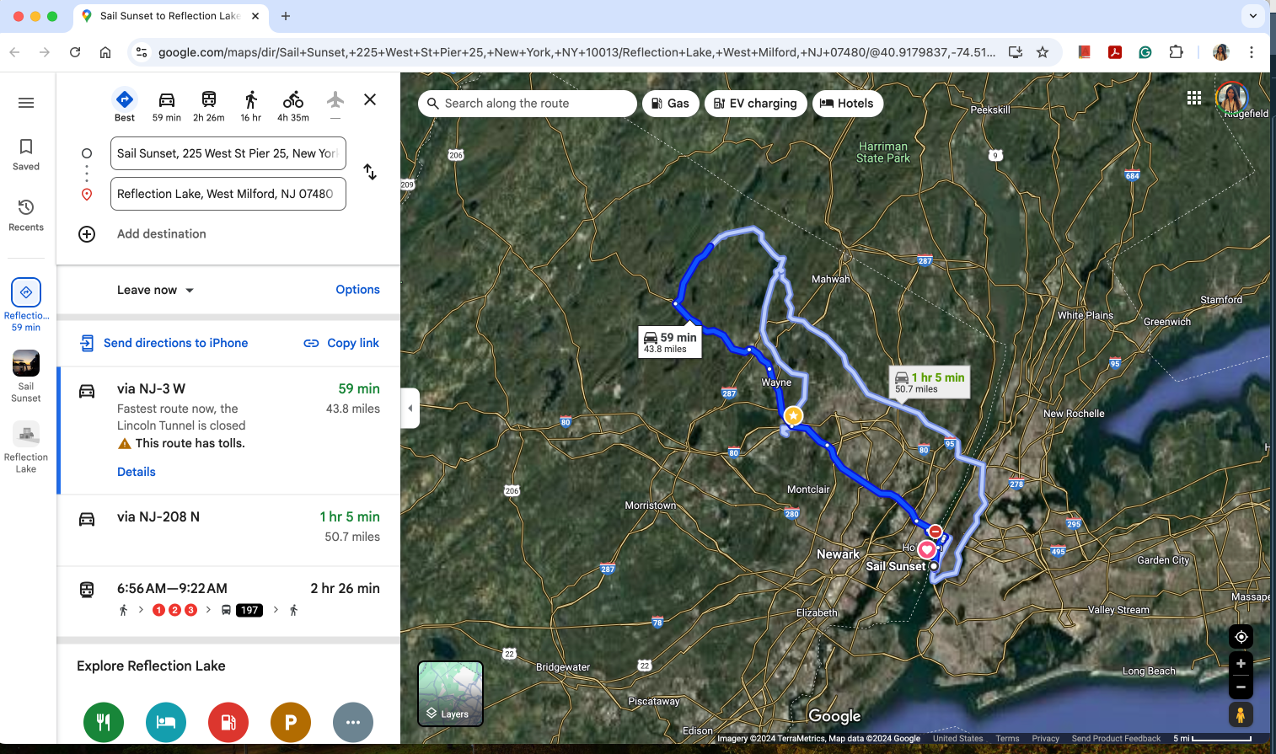
Project Work
Framework
Display top 10 Places with Image, Location Map Link and Checkbox
User
Result Window with checkbox to add into Itinerary
Python Flickr API Call to collect data
Tkinter GUI
Sentiment Analysis on the user comments and get the positive/negative and sentiment score
Database
Google Map API to generate the Map
Fig: WanderSphere Application Framework

Slide 6
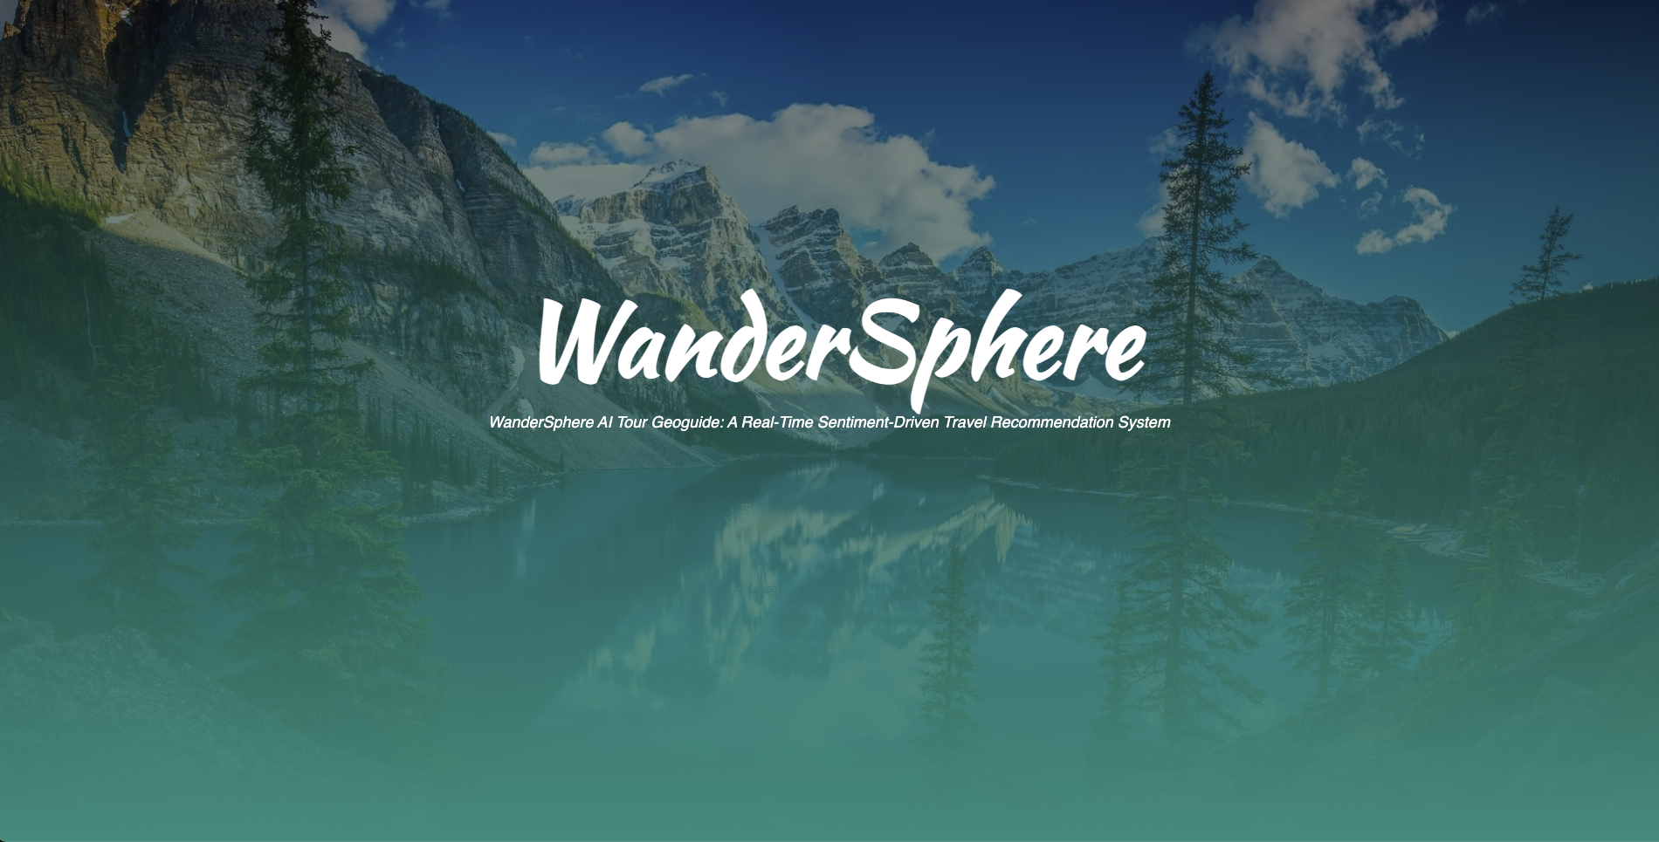
Project Work
Application GUI
Fig: WanderSphere AI Tour Geoguide First User Interface GUI Page

Slide 7
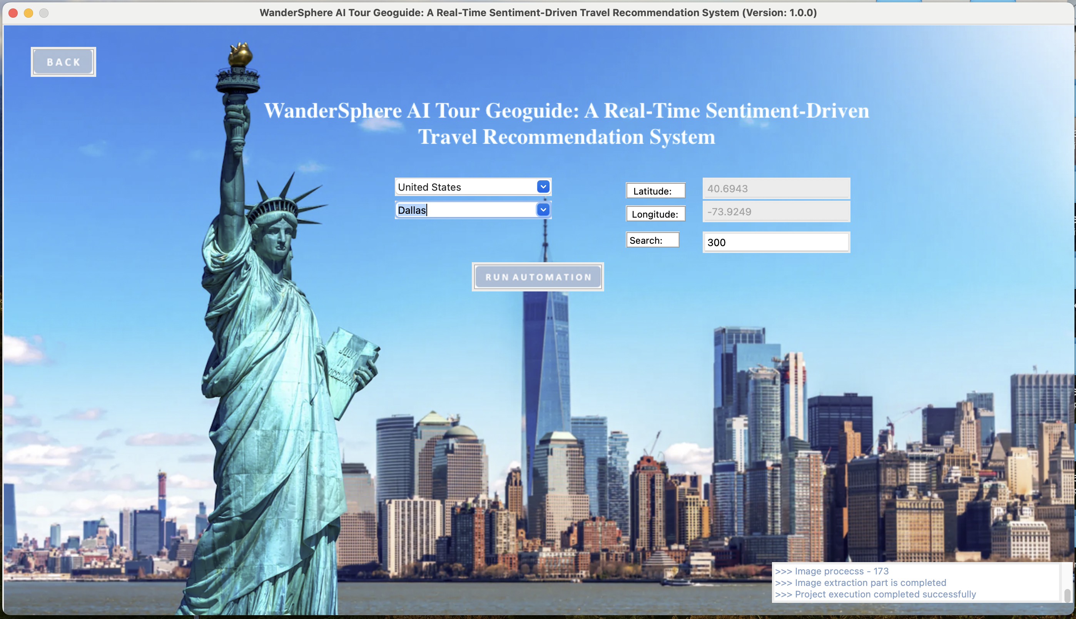
Project Work
Application GUI
Fig: WanderSphere AI Tour Geoguide Main User Interface GUI Page

Slide 8
Project Work
Application GUI
Fig: WanderSphere AI Tour Geoguide First User Interface GUI – Google Itinerary Map

Slide 9
Project Work
Application GUI
Fig: WanderSphere AI Tour Geoguide First User Interface GUI Result Window

Slide 10
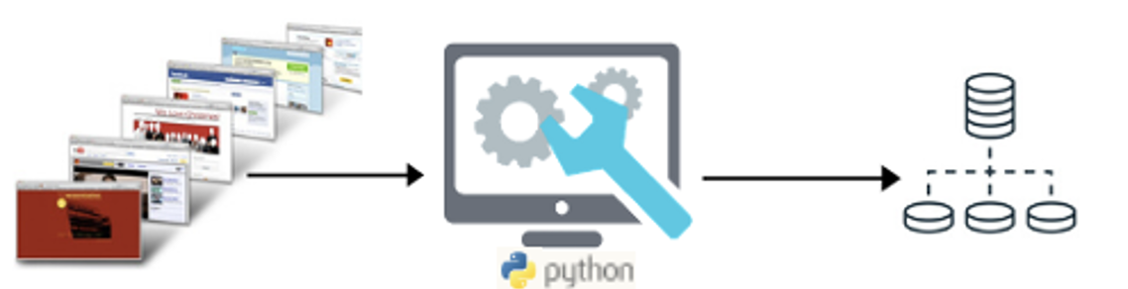
Flickr API
Data Collection
In today’s digital world, data is the key to unlocking valuable insights, and much of this data is available on the web.
Python API call is one of the method for the process of extracting data from websites.
Data collected from Flick API:
api_key = '707492d24c42391a563cddc2bf5e619f'
secret_api_key = '52cb54347825468a’
# Search for photos near the given latitude and longitude
photo_list = flickr.photos.search(lat=lat, lon=lon, accuracy=accuracy, per_page=pagecnt)
Flickr API Call for Data Collection

Slide 11




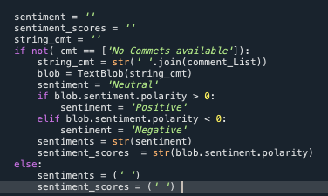
Data Analysis and Data Processing
Sentiment Analysis
What is Sentiment Analysis?
The process of determining the emotional tone or sentiment expressed in a piece of text. The primary goal of sentiment
analysis is to classify the sentiment as positive, negative, and neutral based on the content of the text.
Key Aspects of Sentiment Analysis?
Sentiment Categories: Sentiment analysis typically classifies text into three main categories: Positive, Negative and Neutral
Sentiment Polarity :
Polarity refers to whether the sentiment is positive, negative, or neutral.
Score: Many sentiment analysis models also calculate a compound score (a single numerical value that indicates the overall sentiment).
Common Sentiment Analysis Tools and Libraries:
VADER (Valence Aware Dictionary and Sentiment Reasoner):
Python library for sentiment analysis, specially designed for social media and short text. VADER is fast, effective, and particularly good at handling emojis, hashtags, and slang.
TextBlob:
A simple library for Python that provides basic sentiment analysis and other NLP tasks like part-of-speech tagging and translation.
Hugging Face Transformers (e.g., BERT, DistilBERT, RoBERTa):
Hugging Face is a powerful toolset and framework that provides access to pre-trained transformer models, including BERT, DistilBERT, and RoBERTa.
We have used the TextBlob for the Comment Sentiment Analysis

Slide 12

Python
Tools and Technology
Python Flickr API
Tkinter Library
TextBlob
webbrowser
Pandas
threading
Pillow

Slide 13
Python Files
UML Diagram
Main.py
Flickr_data_collection.py
ExcelUtils.py

Slide 14
Limitation and Future Work
Implement Application for All Country
Add the Instagram Dataset to collect more data
Implement the Website using the Django Framework and deploy for real time use.

Slide 15
References
Personalized Travel Recommendation Systems: A Study of Machine Learning Approaches in Tourism. https://www.researchgate.net/publication/370274670_Personalized_Travel_Recommendation_Systems_A_Study_of_Machine_Learning_Approaches_in_Tourism
Tourism Recommendation System Using Machine Learning chrome-extension://efaidnbmnnnibpcajpcglclefindmkaj/https://ijrpr.com/uploads/V4ISSUE5/IJRPR13339.pdf
Tourism Recommendation Using Machine Learning Approach https://www.researchgate.net/publication/322009706_Tourism_Recommendation_Using_Machine_Learning_Approach
Intelligent recommendation model of tourist places based on collaborative filtering and user preferences https://www.tandfonline.com/doi/full/10.1080/08839514.2023.2203574
Deep Learning Based Tourism Recommendation System. https://papers.ssrn.com/sol3/papers.cfm?abstract_id=4286575

